Slide 1
Group 3
Joseph Soriano, Saurav Subedi, Ryan Tyler, & Joshua Appenzeller

Slide 2


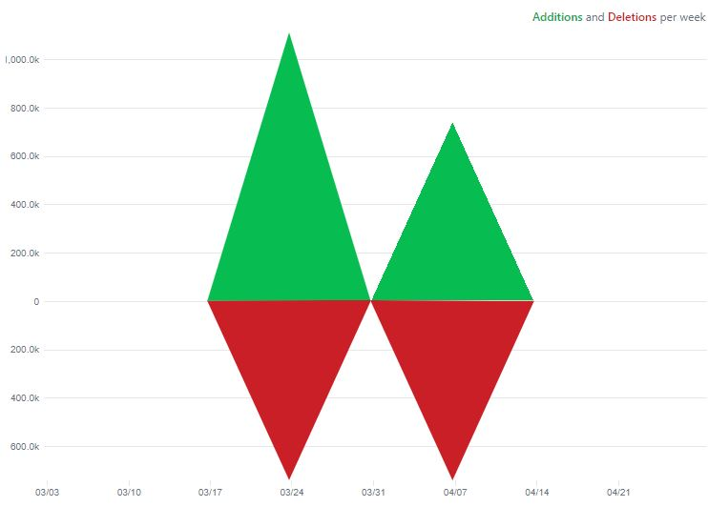


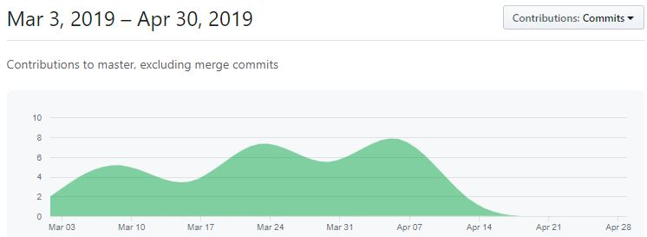

Data over the semester

Slide 3
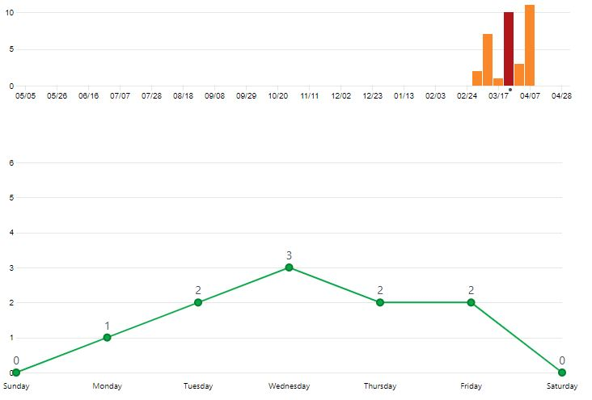
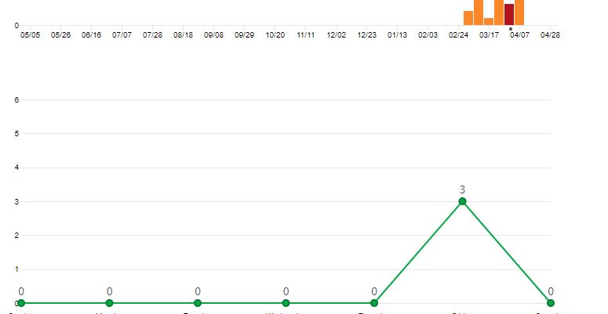
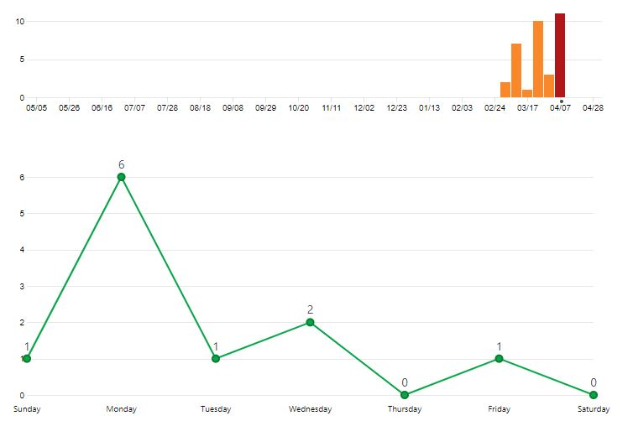
From Initial Submission to Testing Submission
Week of March 24th
Week of March 31st
Week of April 7th

